Slide 1
Introduction to Machine Learning

Slide 2
Basic Terminologies
Machine Learning
Soft Computing
When the solution is not fixed to a problem and cannot be solved using binary/fixed logic
Hard Computing
When there is a fixed solution to a problem and can be solved using binary/fixed logic.
Computational Intelligence
Artificial Intelligence
Also called Machine intelligence and it is some form of intelligence demonstrated by a machine

Slide 3
Basic Terminologies
Machine Learning
It is an application of AI that provides systems the ability to automatically learn and improve from experience without being explicitly programmed.
Soft Computing
Hard Computing
Computational Intelligence
It is a set of nature-inspired computational methodologies and approaches to address complex real-world problems to which mathematical or traditional modelling can be useless
Artificial Intelligence

Slide 4
Types of Machine Learning Algorithms
There are mainly 4 types of ML algorithms
Supervised Learning
In this type of learning algorithms, the expected output for a given input is known a prior.
The machine must be able to map the given input to the expected output.
A set of labelled data called training set is used to make the machine learn the mapping function.
Regression & classification problems are solved
It is mainly used for predictive modelling

Slide 5
Types of Machine Learning Algorithms
Unsupervised Learning
In this type of learning algorithms, the expected output for a given input is not known.
The machine must be able to identify the similarities and/or dissimilarities among the given input samples.
An unlabeled set of data is used for unsupervised learning
Clustering problems are solved
It is mainly used for descriptive modelling

Slide 6
Types of Machine Learning Algorithms
Semi-supervised Learning
In this type of learning algorithms, the machine is trained on combination of labeled and unlabeled dataset
The combination contains a very few labeled data and very large amount of unlabeled data
Reinforcement Learning
In this type of algorithms, the machine learns using trial and error basis.
The machine learns from past experience and tries to capture the best possible knowledge to make accurate decisions based on the feedback received

Slide 7
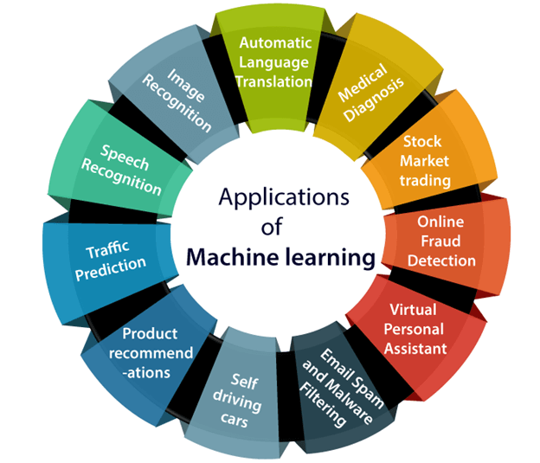
Applications of Machine Learning

Slide 8
Evaluating Machine Learning Techniques
True positives (TP): Predicted positive and are actually positive.
False positives (FP): Predicted positive and are actually negative.
True negatives (TN): Predicted negative and are actually negative.
False negatives (FN): Predicted negative and are actually positive.

Slide 9
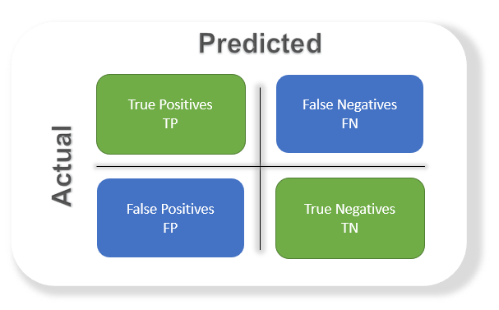
Evaluating Machine Learning Techniques
Confusion matrix
It’s just a representation of the above parameters in a matrix format.

Slide 10



Evaluating Machine Learning Techniques
Accuracy
Doesn’t work well with imbalance dataset
Precision
Percentage of positive instances out of the total predicted positive instances.
Recall/Sensitivity/True Positive Rate
Percentage of positive instances out of the total actual positive instances

Slide 11


Evaluating Machine Learning Techniques
Specificity/True Negative Rate
Percentage of negative instances out of the total actual negative instances
F1 score
It is the harmonic mean of precision and recall. This takes the contribution of both, precision as well as recall

Slide 12


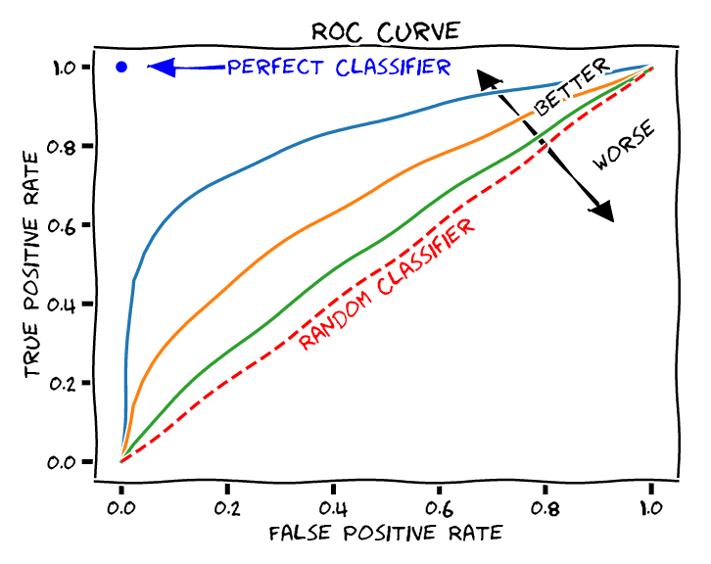
Evaluating Machine Learning Techniques
ROC curve
ROC stands for receiver operating characteristic and the graph is plotted against TPR and FPR

Slide 13
